Slide 1



Presentation
Team 3C
Introduction
1.Susmith Kumar Koripelli susmithkoripelli@gmail.com 2.Jay Mane 10jaymane@gmail.com 3.Vedant Dhamale vedantdhamale9@gmail.com 4.Kritika Rambhad gudirambhad@gmail.com 5.Prashanth Reddy varangantipr@gmail.com

Slide 2

1
Introduction
2
Dashboard Overview
3
Key Decisions and Design Choices
4
Challenges Faced
Agenda
5
Solutions Implemented
6
Insights Derived
7
Addressing Key Questions
8
User Interaction and Guidance
9
Visual Highlights
10
Impact on Decision-Making

Slide 3
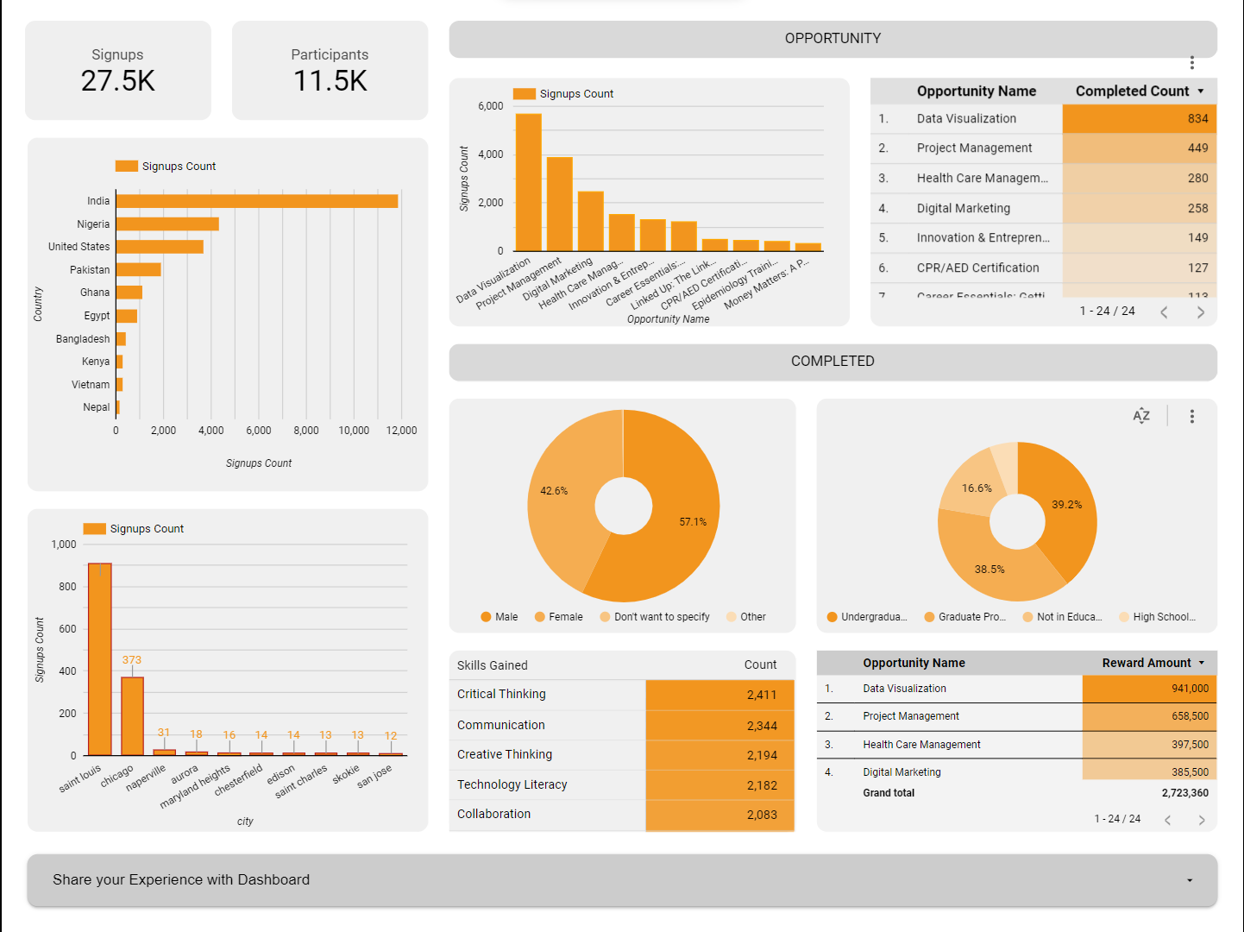
Dashboard
Overview

Slide 4



Key decisions and Design choices​
1
Separate Sections dedicated to Platform Signups, Opportunity Signups, Opportunity Completed.
2
Use of Bar charts for visualizing ranked records within the dashboard.​
3
Use of Pie charts to communicate demographic insights within the dashboard.
4
Heatmaps for Top records.

Slide 5

Challenges Faced
Inconsistent Values in the City Column like (“Saint Louis”, St Louis”, “SAINT LOUIS”, “st louis”).​
High Number of Null Values in the Gender Column.​
Presence of "Other" in the City Column.​
The Skills column contained entries in list format, making it challenging to extract and analyze the top skills efficiently.​
High Number of Null Values in Multiple Opportunity-Related Columns.​

Slide 6

Solutions Implemented​
The implementation of data standardization and normalization techniques resulted in a clean and uniform City column.​
To mitigate the impact of null values, we employed advanced imputation strategies.​
The City column contained a significant number of entries labeled as "Other,“ were not considered and was excluded from Insights.​
With the dedicated skills dataset, we applied normalization techniques to ensure consistency and standardization of skill entries.​
To tackle the challenge posed by multiple opportunity-related columns having a significant number of null values, we initially separated the dataset and we opted for a selective deletion approach.​

Slide 7
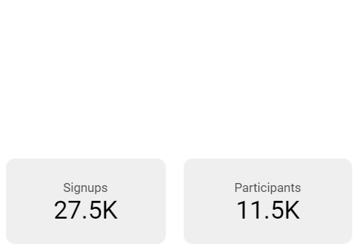
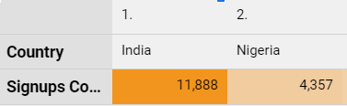
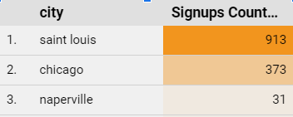
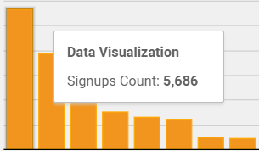
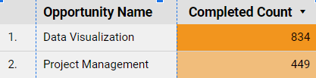
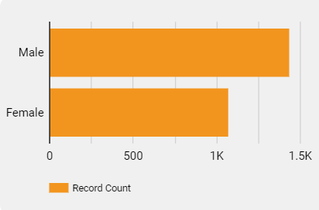
Insights Derived
Excelerate Achieves a Conversion Rate of 41.8%, Converts 27.5k Platform Sign-Ups into 11.5k Active Opportunity Participants.
India leads in total number of sign-ups on platform i.e : 11,888,while Saint Louis stands out as the city in the
United States with most number of signups on platform i.e :913.
Data Visualization Opportunity has garnered the highest total sign-ups, totaling 5686, and also boasts the
highest completion count, reaching 295.
57.1% of students who successfully completed opportunities were male, while 42.6% were female,
with the remaining categorized as other.

Slide 8
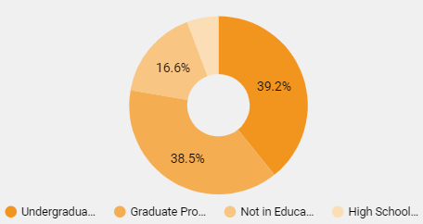
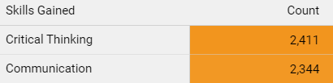
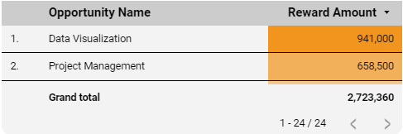
Insights Derived
Opportunity Completion Reflects Academic Diversity, with 39.2% Undergraduates and 38.5% Graduate Students.
Predominant Skill Gained by Opportunity Completers is Critical Thinking.
Data Visualization Opportunity Leads with the Highest Rewards Awarded i.e 941,000 , Contributing to a Total of 2,723,360 Across All Opportunities.

Slide 9
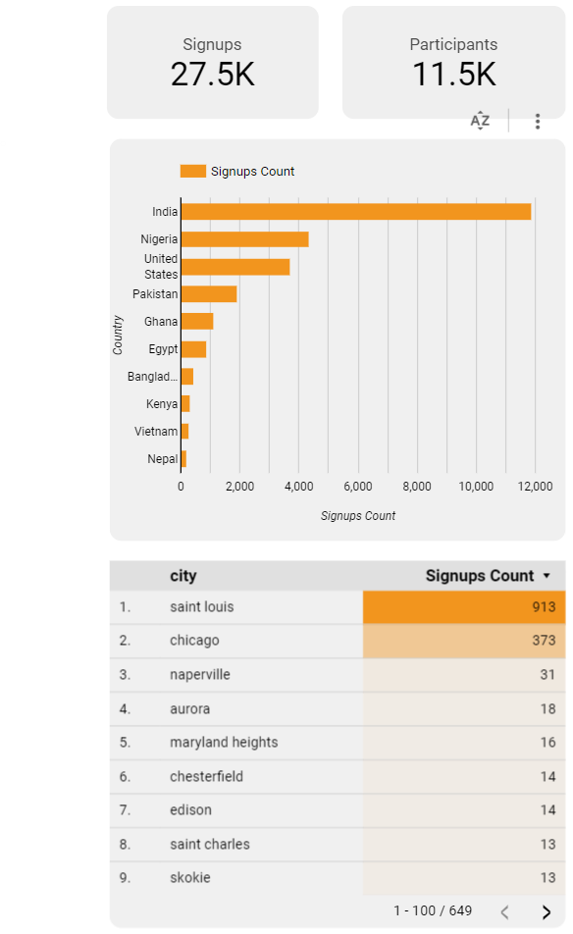
Addressing Key Questions​​
How many people are signed up on the platform, and how many of those have signed up for opportunities?​
What are the top 10 countries learners have signed up from?​
What are the cities in the US learners have signed up from?

Slide 10
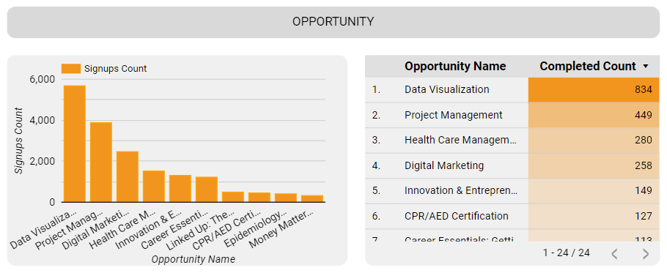
Addressing Key Questions​​
1.Which is the most popular opportunity learners have signed up for?
2.Which is the most popular opportunity learners have completed?

Slide 11
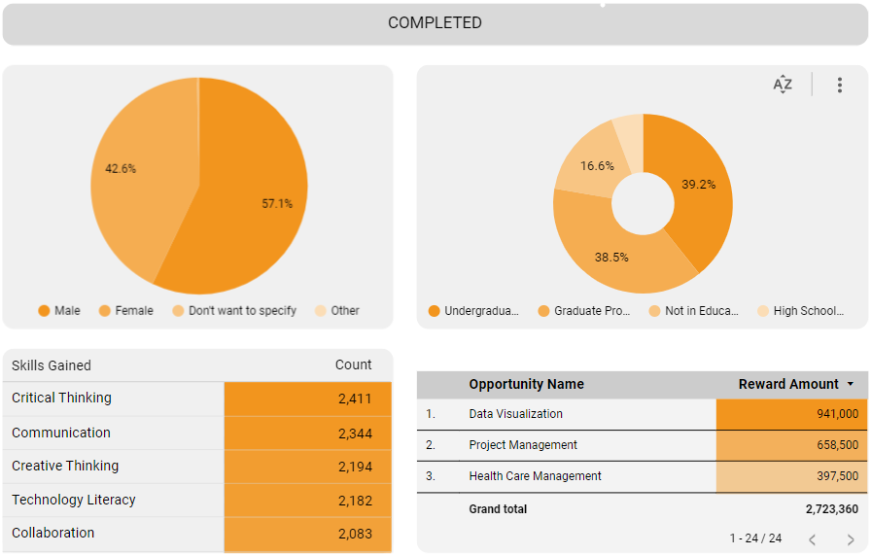
Addressing Key Questions​​
1.What is the demographic (gender, student status, etc.) of those who have signed up and completed?
2.What are the most gained skills on Excelerate?
3.How much is the total scholarship awarded and through which opportunities?

Slide 12


User Interaction and Guidance​
01
Intuitive Navigation
The dashboard incorporates an intuitive navigation system, allowing users to seamlessly explore different sections and insights.​
02
Interactive
Visualizations
Visualizations within the dashboard are designed to be interactive, enabling users to drill down into specific data points for a more detailed analysis.​
03
Robust filtering
Robust filtering options are integrated, allowing users to customize their view based on specific criteria.
04
Feedback mechanism
To foster continuous improvement, a user feedback mechanism is embedded within the dashboard.

Slide 13

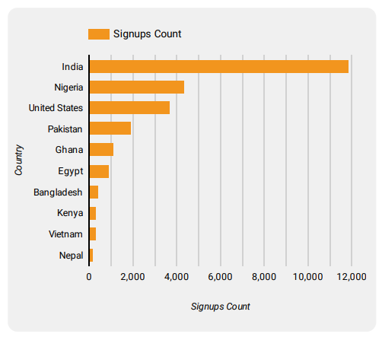
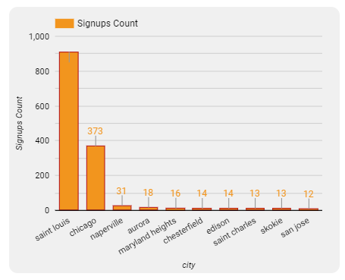
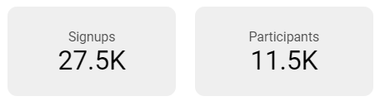
Visual Highlights​
Bar Graph Column chart
Scorecards

Slide 14
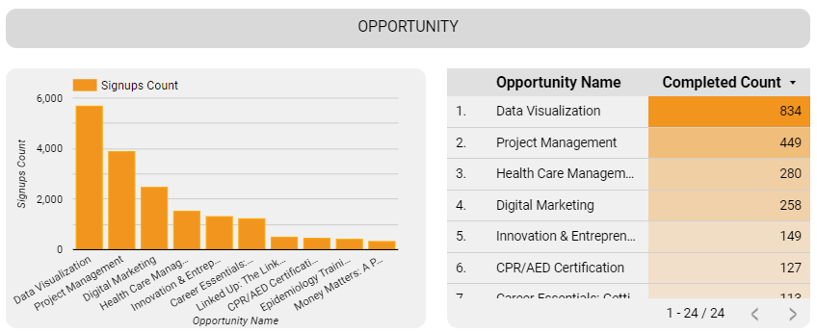
Visual Highlights​
Column Chart Table With Heatmap​

Slide 15
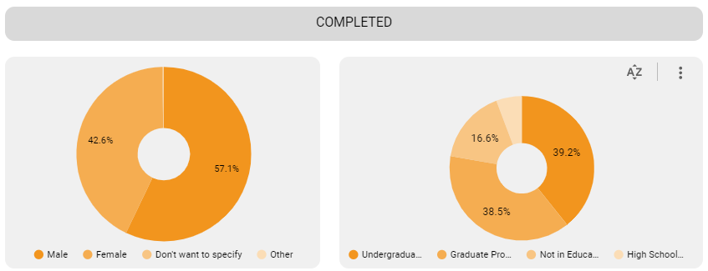
Visual Highlights​
Pie Chart Doughnut chart​

Slide 16
Impact on Decision-Making
1
The dashboard's metrics facilitate data-driven evaluations of program effectiveness.
2
Understanding skill acquisition trends enables Excelerate to adapt its skill development initiatives proactively.
3
The insights derived from the dashboard allow for efficient management and optimization of internship programs.
4

Slide 17

THANK YOU
Regards : Team 3C​

